Slide 1
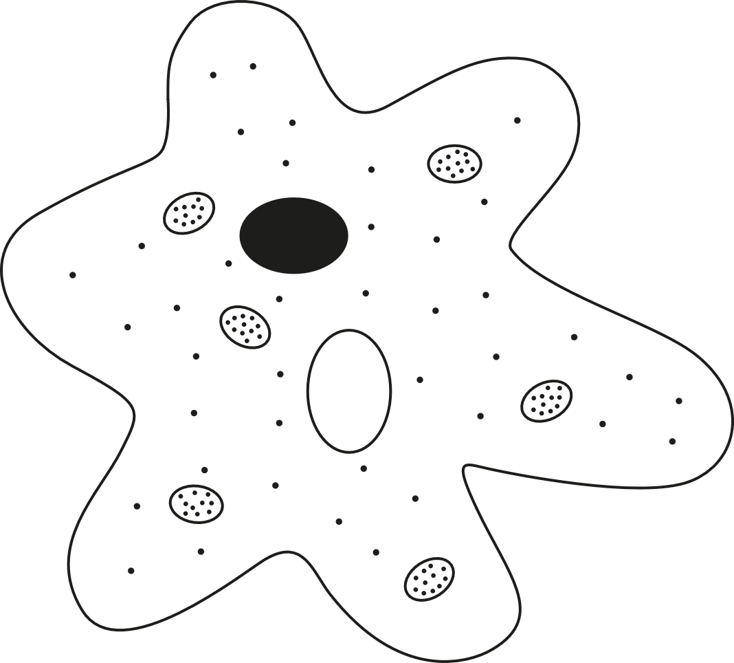
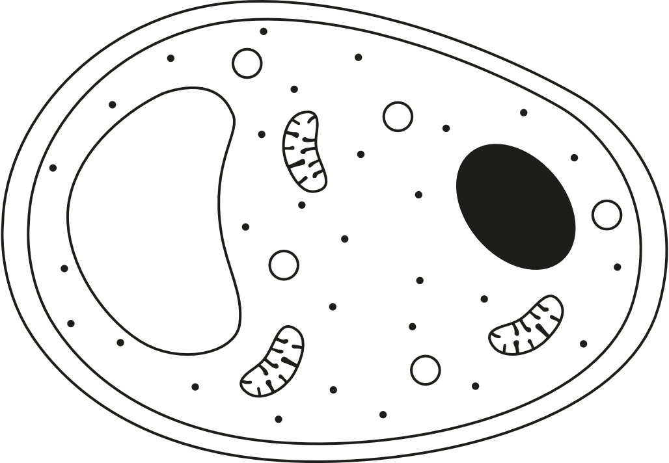
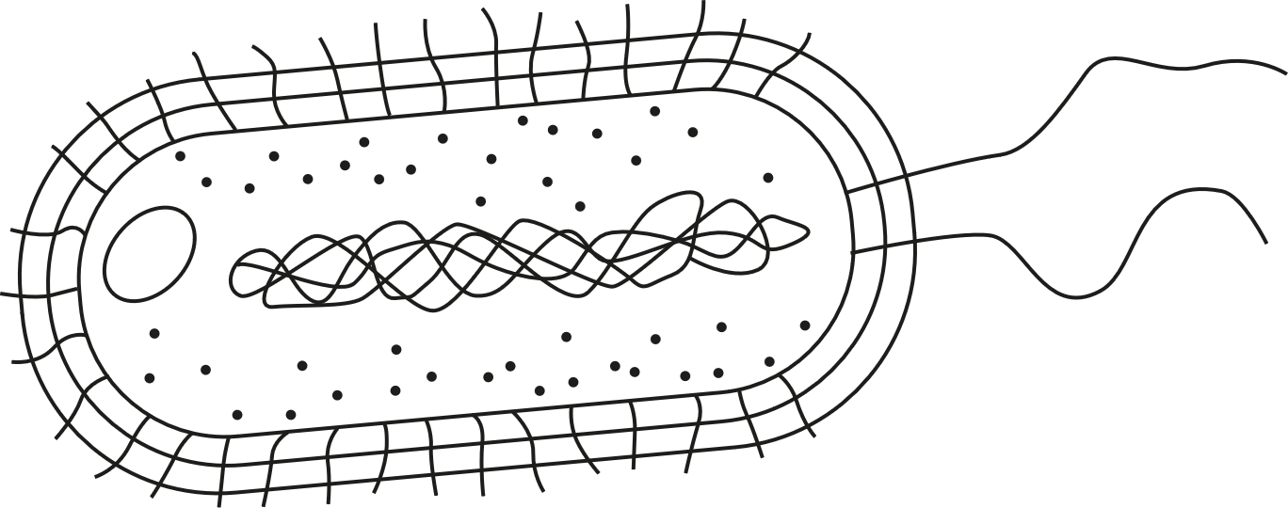
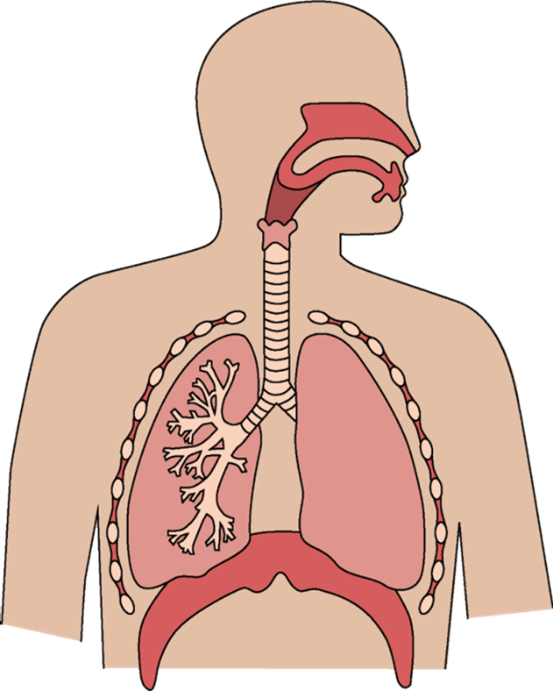
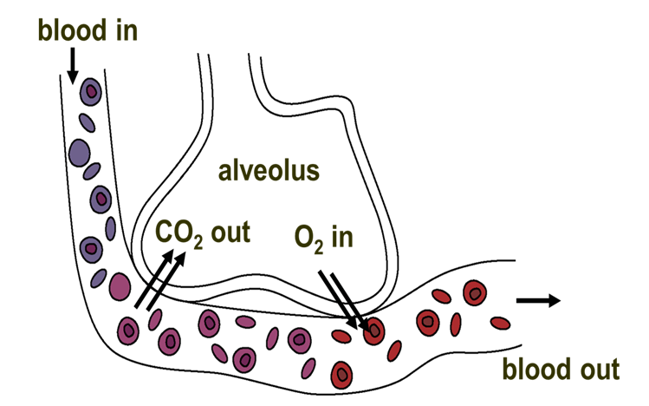
Organ systems
Unicellular organisms are made of only one cell (e.g. bacteria, amoeba and yeast).
They can carry out the 7 life processes of living organisms, all in one cell.
Unicellular organisms share common organelles, but they also have adaptations.
Unicellular organisms can be helpful or harmful.
Unicellular organisms use diffusion to exchange substances.
Multicellular organisms are made of many cells (e.g. plants and humans).
They are larger and more complex than unicellular organisms.
They cannot rely on diffusion alone for exchanging substances.
Multicellular organisms depend on tissues, organs, and organ systems working together to exchange and transport substances to cells of the body, to keep cells alive.
Organ systems in humans include the gas exchange system, digestive system, circulatory system, skeletal system and muscular system.
cell wall for strength and support
genome loose in cytoplasm
no cell wall for changing of shape and free movement
bacterium
flagella for movement
amoeba
yeast
Used in baking
Used to make alcoholic drinks
Supports digestion
Used to make cheese and yoghurt
Breathing involves changes in pressure and volume inside the chest, helped by the movement of intercostal muscles and diaphragm, which causes the movement of the ribcage.
Vital capacity is the maximum volume of air exhaled after inhaling fully and can be used to estimate lung volume.
Gas exchange system
Air is a mixture of gases, including oxygen and carbon dioxide.
The human gas exchange system allows for the exchange of oxygen and carbon dioxide between an organism and its environment. Inhaled air contains more oxygen than exhaled air. Exhaled air contains more carbon dioxide than inhaled air. Oxygen moves from the alveoli into cells and then into the blood vessels (capillaries), while carbon dioxide moves in the opposite direction via diffusion.
 | Inhalation | Exhalation
Intercostal muscles | contract | relax
Ribcage | pulled up and out | released down and in
Diaphragm | contracts and moves downwards | relaxes and moves upwards
Volume in the chest | increases | decreases
Pressure in the chest | decreases | increases
Movement of air | into the lungs | out of the lungs
Alveoli are
adapted for
efficient diffusion:
good blood
supply maintains
the concentration
difference
large surface area for faster rate of diffusion
thin walls (one cell thick) to provide a shorter diffusion pathway
trachea
nose
ribs
bronchi
intercostal muscle
bronchioles
lungs
alveoli
diaphragm
Science | 7.05 – Organ Systems| Knowledge Organiser
Notes:
Images:
All images – United Learning

Slide 2
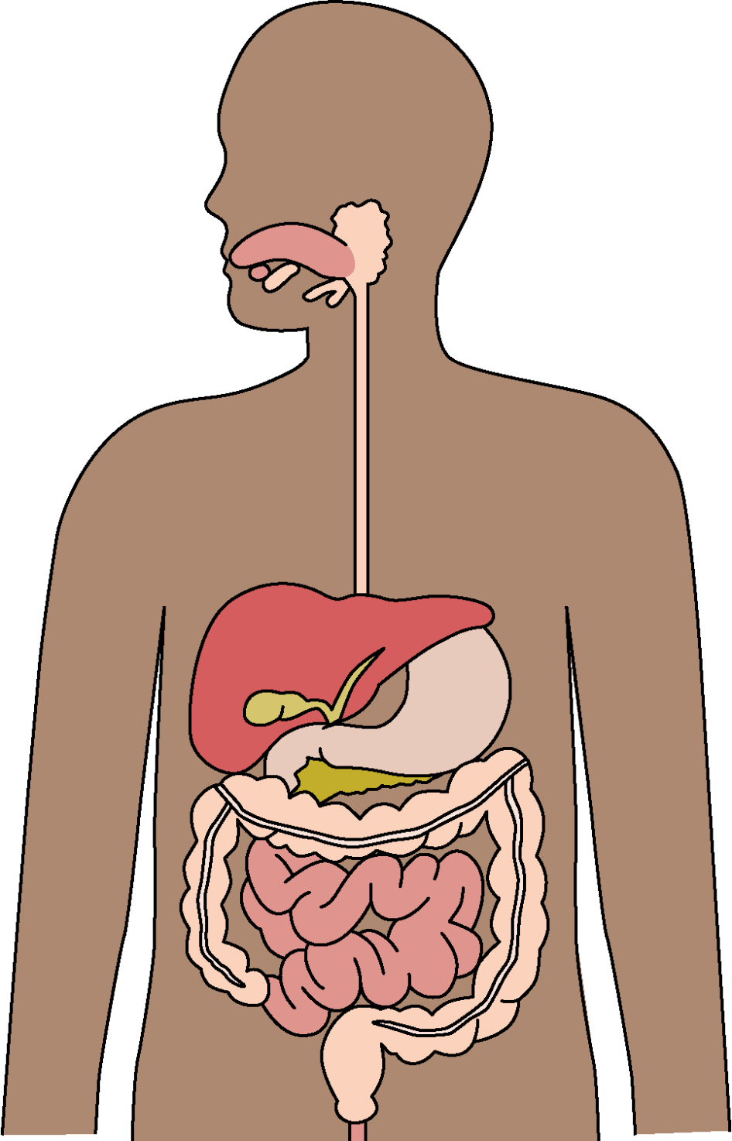
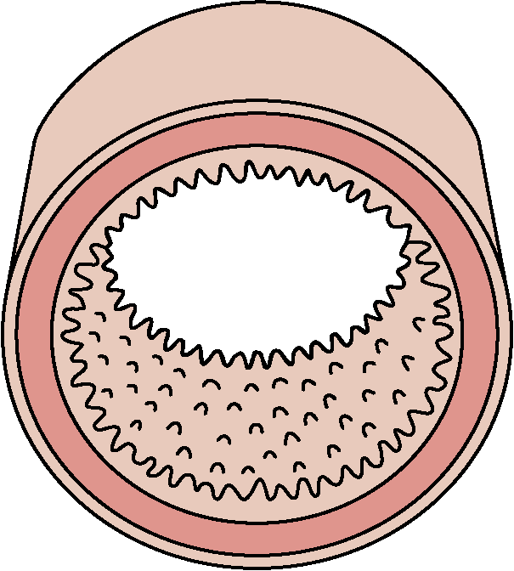
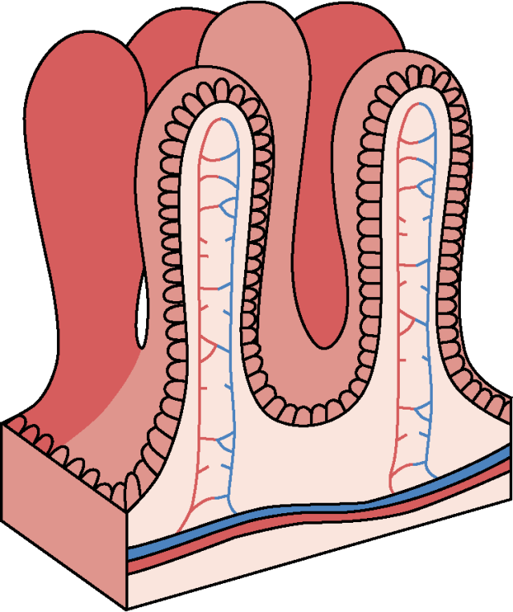
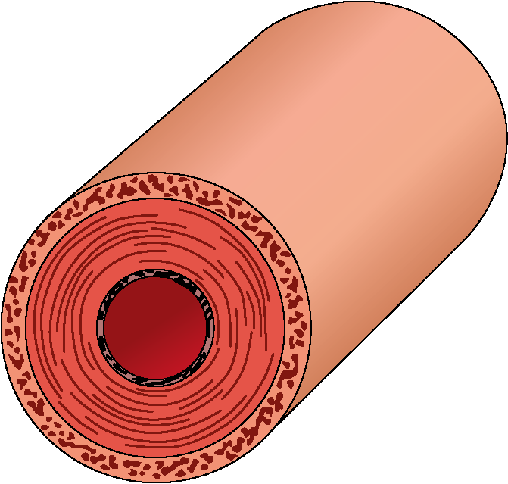
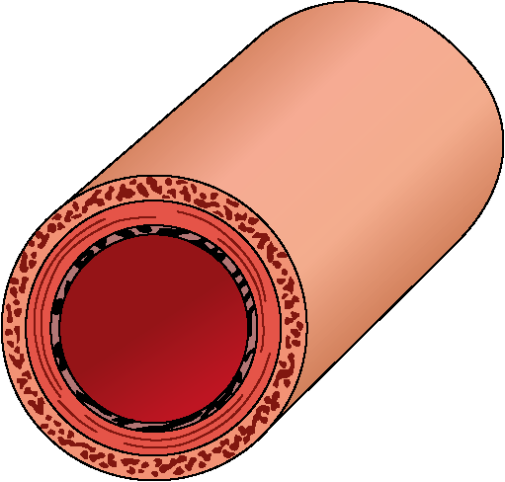
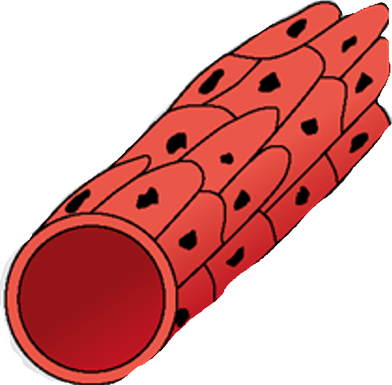
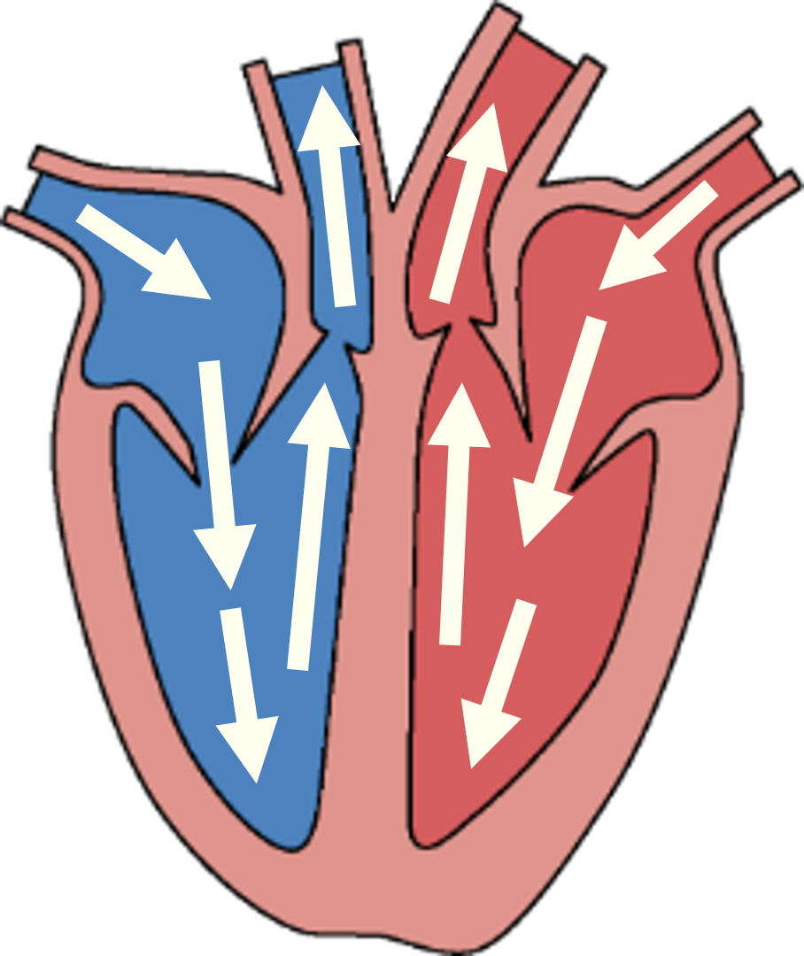
Organ systems
Digestive system
The mouth performs both mechanical digestion (chewing) and chemical digestion (saliva).
Adaptations:
The small intestine is covered in many villi for efficient absorption by diffusion:
villi provide a large surface area for faster rate of diffusion
villi have good blood supply to maintain the concentration difference
villi have thin walls (one cell thick) to provide a shorter diffusion pathway
The human digestive system breaks down large, insoluble food molecules into small, soluble molecules so that they can be absorbed into the blood.
Mechanical digestion:
the physical breakdown of food into smaller pieces.
Chemical digestion:
the use of chemical substances to break food down into smaller molecules.
The oesophagus connects the mouth to the stomach and uses peristalsis to push food down.
The stomach performs both mechanical digestion (muscular tissue contracts) and chemical digestion (glandular tissue producing chemical substances).
The small intestine breaks down food chemically. Absorption of digested nutrients also happens here.
villi
small intestine
The large intestine reabsorbs water from undigested food back into the blood.
Faeces (poo) are stored in the rectum.
Faeces and waste gases are egested from the anus.
Circulatory system
The circulatory system transports useful molecules and waste around the body. The human circulatory system consists of the heart, blood and blood vessels.
The heart has four chambers: two atria and two ventricles.
Valves ensure blood flows in the right direction.
The septum separates the right and left sides of the heart.
Arteries | Capillaries | Veins
Blood taken away from heart High pressure blood Thick muscular and elastic walls Small lumen | Exchange substances between blood and cells Very low pressure blood Very thin walls (one cell thick) Very small lumen | Blood brought back to heart Low pressure blood Thin walls Large lumen Valves prevent back flow
right atrium
left atrium
The heart pumps oxygenated blood from the lungs to the body and deoxygenated blood from the body to the lungs (double circulatory system).
valve
right ventricle
left ventricle
septum
Science | 7.05 – Organ Systems| Knowledge Organiser
Notes:
Images:
All images – United Learning

Slide 3
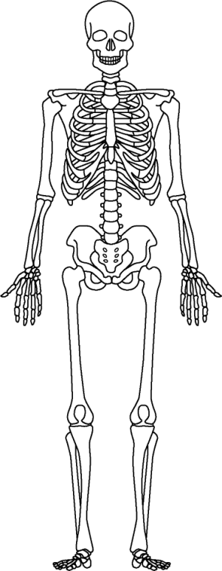
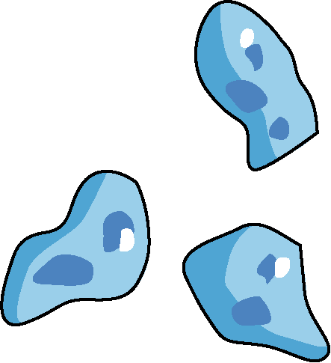
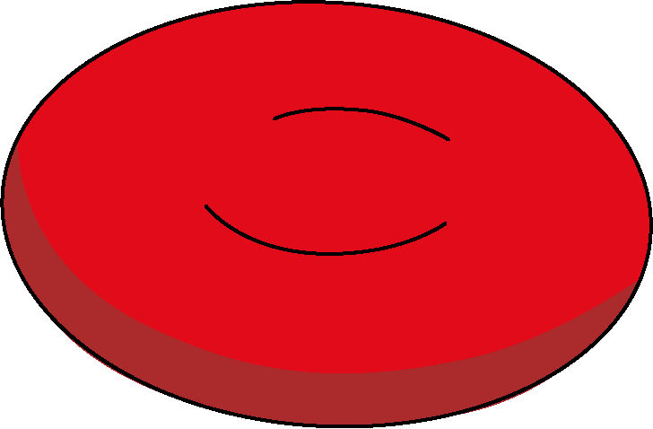
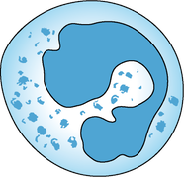
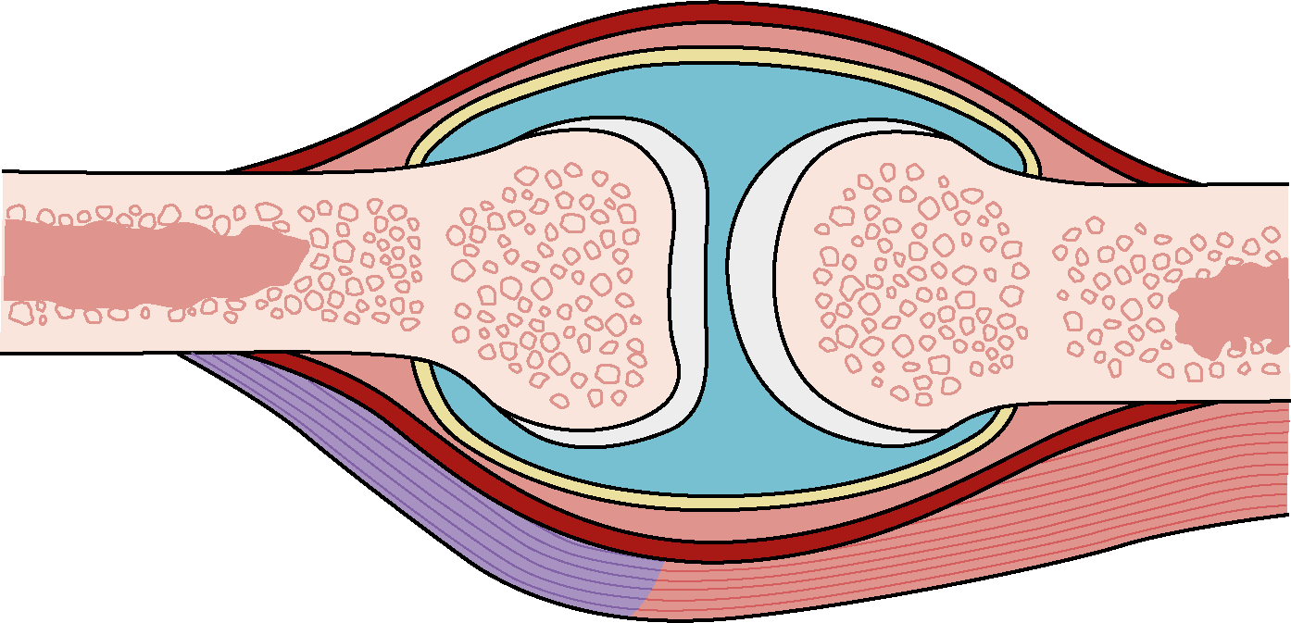
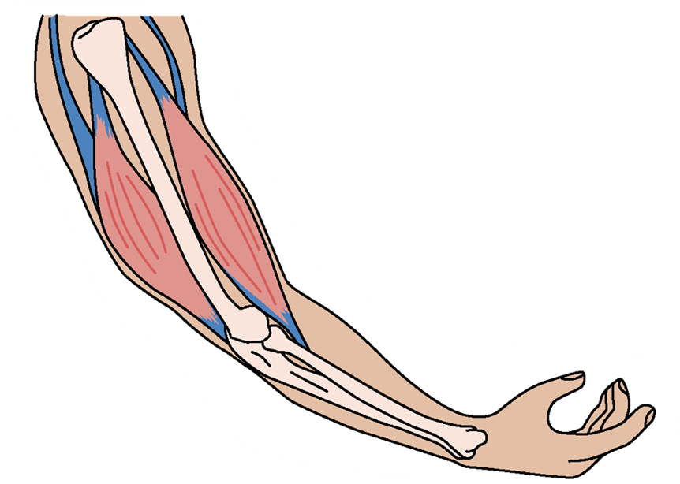
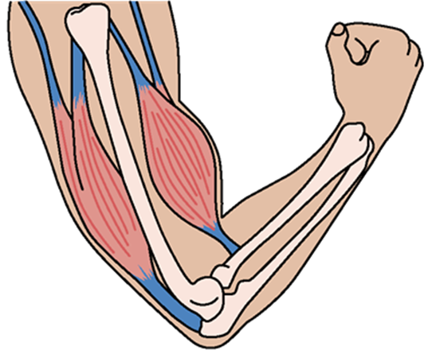
Organ systems
Skeletal system
Four functions of the skeletal system are support, movement,
making new
blood cells and protection of organs (e.g. the cranium protects the brain and
the ribcage protects the heart and lungs).
Bones are living tissues that grow and change.
cranium
Circulatory system (continued)
ribcage
Blood is a fluid that transports substances, useful molecules and waste around the body.
Blood helps the body to defend against diseases and to form scabs to heal cuts.
humerus
vertebrae
Platelets help with blood clotting for wound healing.
Plasma carries the other blood parts, nutrients, waste and carbon dioxide.
It is yellow coloured and mostly water.
pelvis
v
CO₂
ulna
nutrients
waste
radius
Red blood cells carry oxygen to all the cells of the body.
White blood cells help defend against disease.
Red blood cells, white blood cells and platelets are made in the bone marrow - soft tissue inside large bones protected by the hard part of the bone around it.
femur
Adaptations of the red blood cells:
biconcave shape →large surface area for faster oxygen diffusion
contains haemoglobin → carry oxygen
no nucleus → space for more haemoglobin → more oxygen
tibia
fibula
Joints, muscles and movement
A joint is the point where two or more bones meet in the body.
Joints connect bones and allow the body to move and bend. Different joint types allow various movements:
hinge joint: movement backwards and forwards e.g. the knees and elbows
ball-and-socket joint: movement in many directions e.g. the hips and shoulders
pivot joint: twisting movement around a fixed point e.g. the neck
fixed joint: does not allow for any
movement e.g. in the cranium
cartilage reduces friction and absorbs forces
Muscles can only pull, they cannot push;
Muscles work in antagonistic muscle pairs. When one muscle contracts to pull the bone in one direction, the other muscle relaxes to allow movement.
ligaments connect bones in a joint
synovial fluid lubricates joints
to prevent friction
biceps contracted
biceps relaxed
bone
bone
triceps relaxed
triceps contracted
tendons connect muscle to bone
muscle contracts or relaxes to move bone
The way in which muscles and bones work together to exert forces is called biomechanics.
Muscle strength varies based on muscle size, age, sex, training, nutrition and injury.
Ageing can lead to joint wear, inflammation and arthritis. Arthritis causes joint pain and affects synovial fluid and cartilage.
Science | 7.05 – Organ Systems| Knowledge Organiser
Notes:
Images:
All images – United Learning

